Slide 1
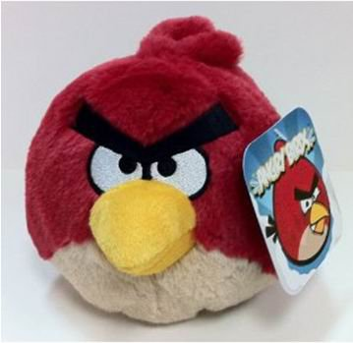

Rendering Techniques and Applications Final Project
4099056008 資工四 陳昱全
4099056030 資工四 黃湋縜

Slide 2
Content
○ Member contribution
○ Goal
○ Introduction
○ Code description
○ Results
○ Feedback
○ Reference

Slide 3
Member contribution
陳昱全 : Program structure design and implement, Socket programming , Multithread programming , Characters design, Sound programming, XML file handling … 100%
黃湋縜 : Program structure design and implement, Characters design, Scene design, Multithread programming, FBX Loader implement, Program User interface design … 100%

Slide 4
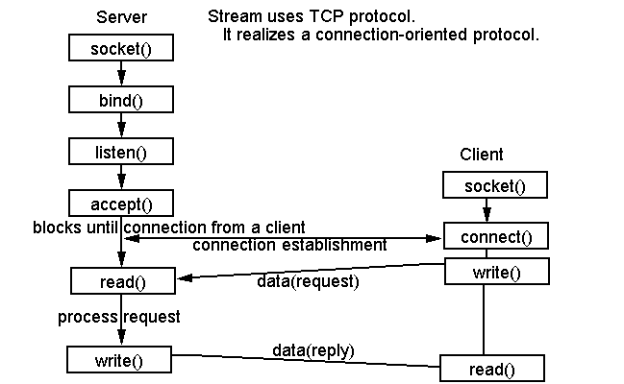
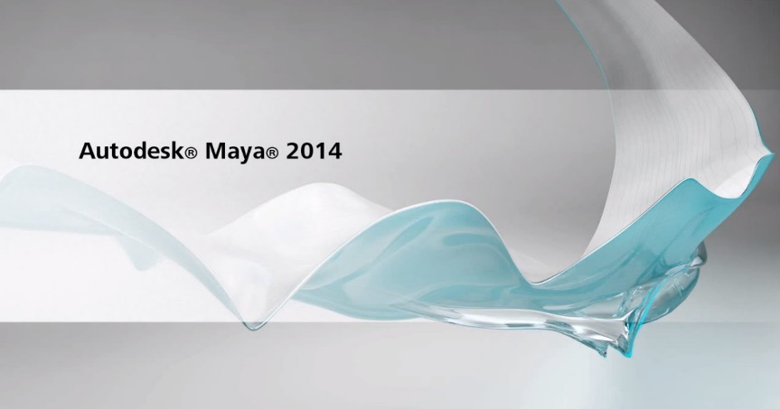

Goal
1.必須寫出隊友看的懂的程式（*ﾟДﾟ）
2.連線版互砍還沒有人寫過，嘗試實作
3.Obj沒有動畫，嘗試使用Fbx
4.DisplayList instead of CPU calculating
5.Autodesk Maya and Autodesk 3DS MAX
6. XML

Slide 5

Introduction
連線版對戰遊戲，雙方可選角色進行對戰，直到其中一方生命值歸零即結束遊戲!!

Slide 6
Code description – Socket programming
Start
Start
Server
Client
SelectCharacter()
SelectCharacter()
LoadingServerModelThread()
LoadingClientModelThread()
Loading()
Loading()
Connect()
data
Connect()
LoadingClientModelThread()
LoadingServerModelThread()
Loading()
Loading()
false
Wait()
data
Wait()
false
true
true
EnterGame()
EnterGame()

Slide 7
Code description – Socket programming
EnterGame()
EnterGame()
Server
Client
SendThread()
SendThread()
ReceiveThread()
ReceiveThread()
data
Draw()
Draw()
. . .
. . .
Exit()
Exit()

Slide 8

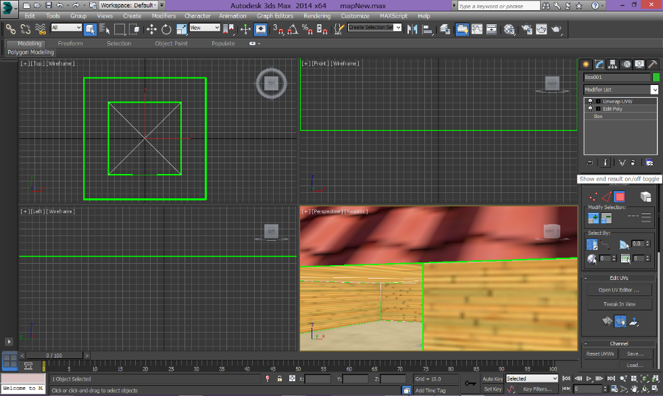
Code description – Collision detection
Using image file to implement collision detection
Advantage
Easy to generate scene and collision data
Low time complexity
Extension : become a height map

Slide 9

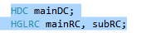
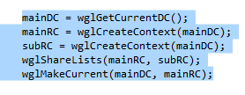
Code description – Loading thread
Thread 1
OpenGL multithreading
Windows program : Device context
OpenGL program : Rendering context
Thread 2

Slide 10
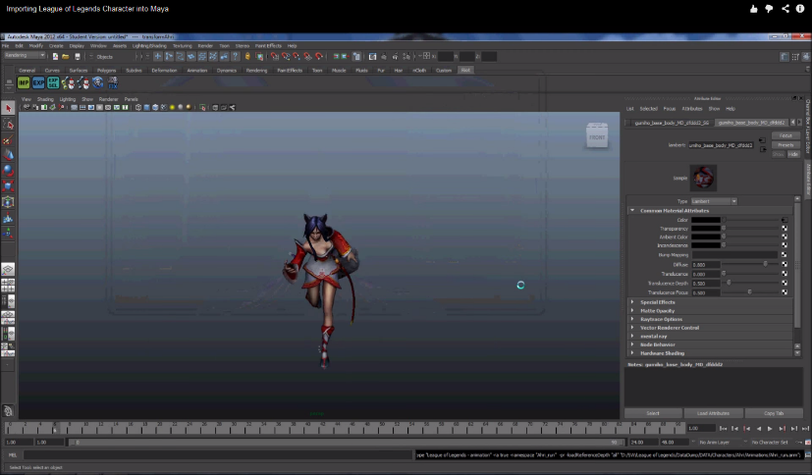
Code description – Model loading
Export models form league of legends
RiotFileTranslator v2.0b (by ThiSpawn) (for Autodesk Maya)
Transcoding to FBX file
Load FBX file by FBX Software Development Kit
Advantage :
Autodesk provides FBX SDK to access FBX file ( which has OpenGL sample code )
Disadvantage:
The data format doesn’t open

Slide 11
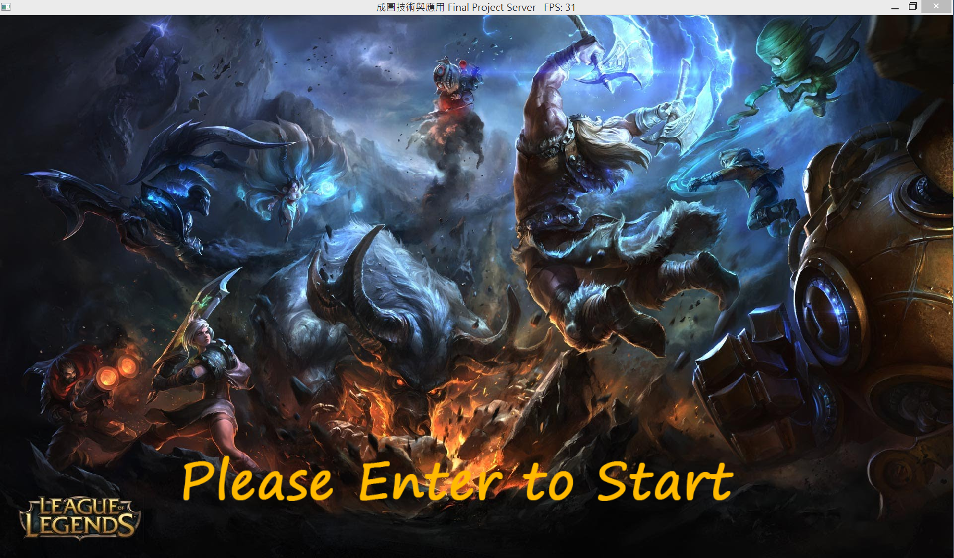
Results

Slide 12









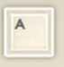

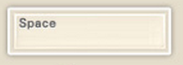




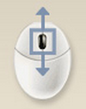

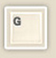
+
移動角色人物
移動角色人物視角
+
攻擊
衝刺
改變視角遠近
F : 全螢幕
L : 探照燈
T : 滑鼠鎖定
開啟/關閉 霧

Slide 13
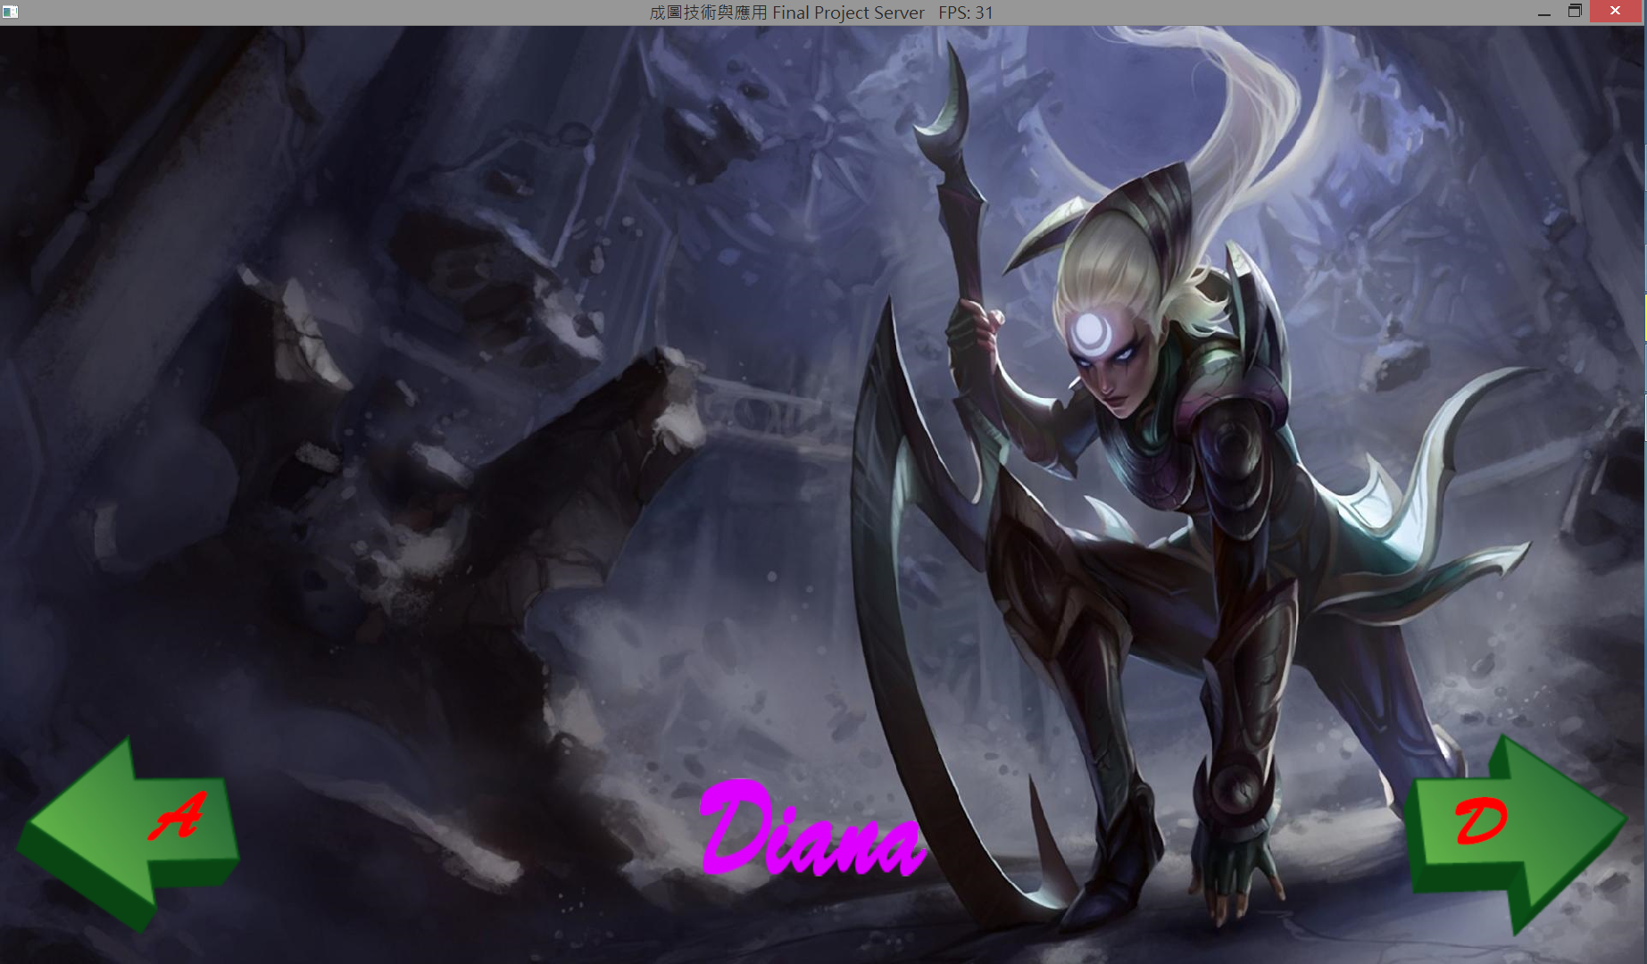
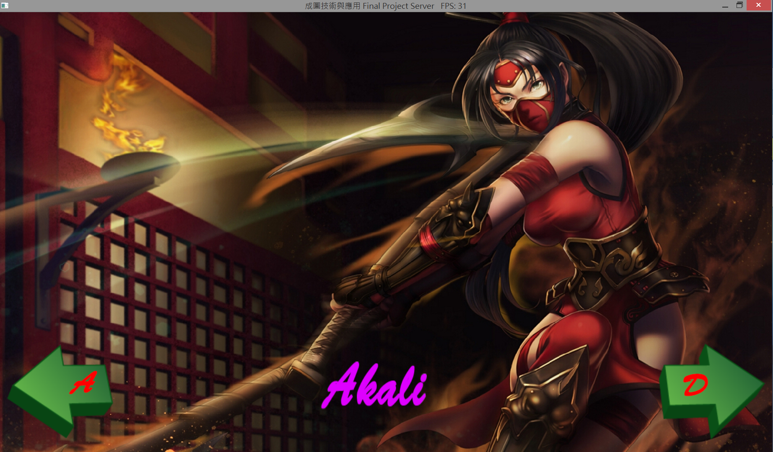
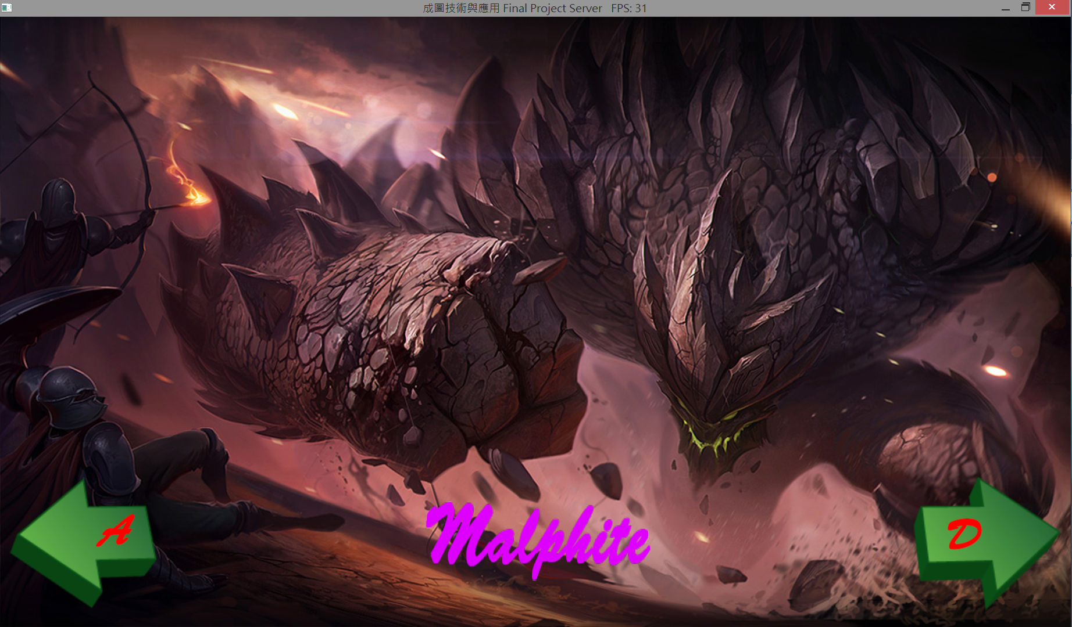
Results

Slide 14
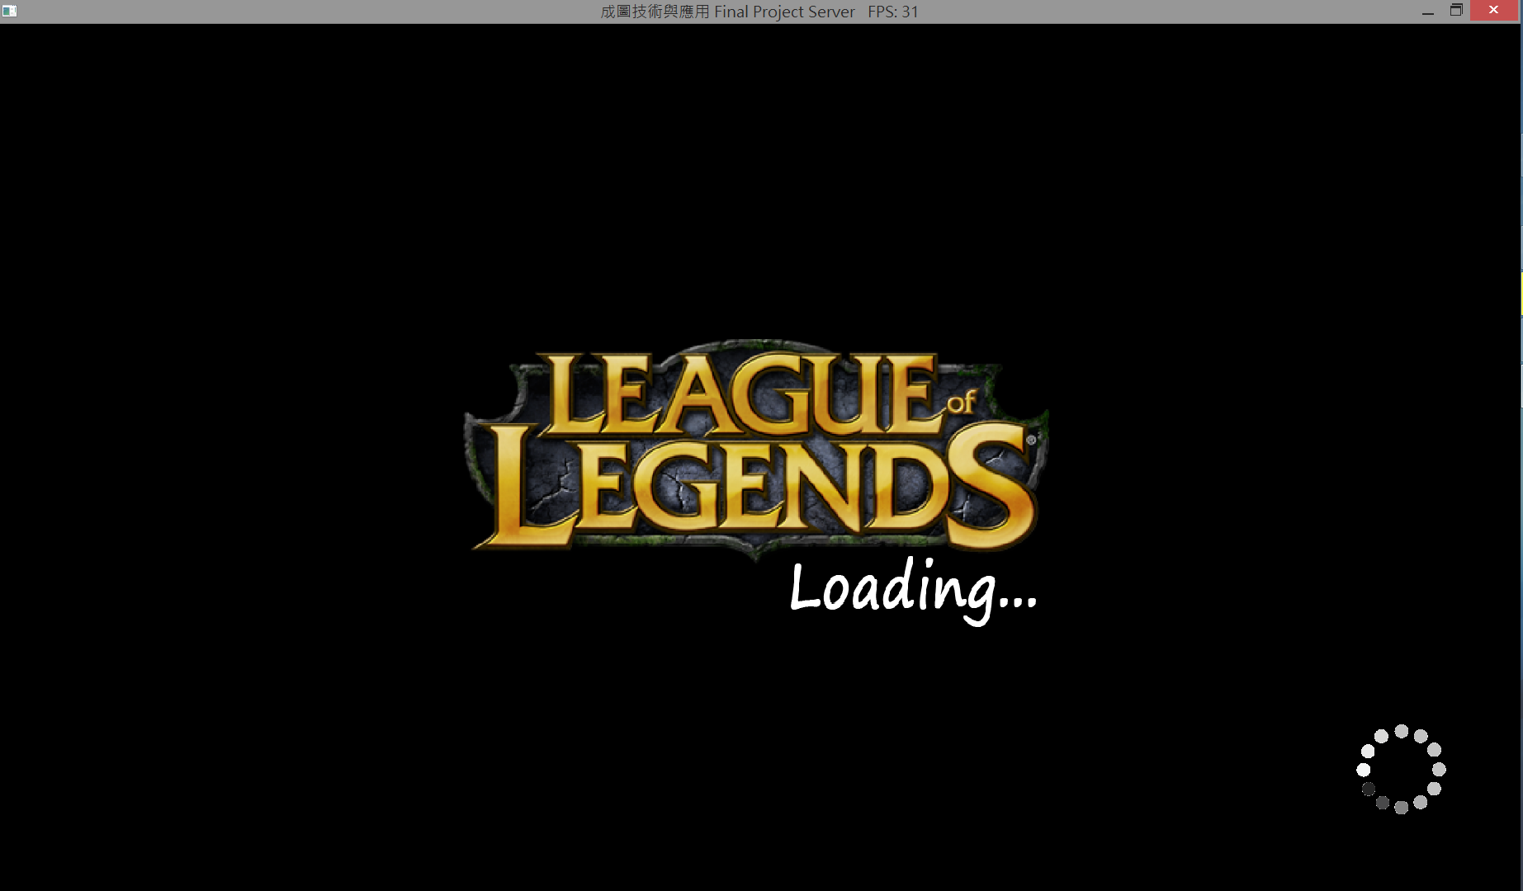
Results

Slide 15
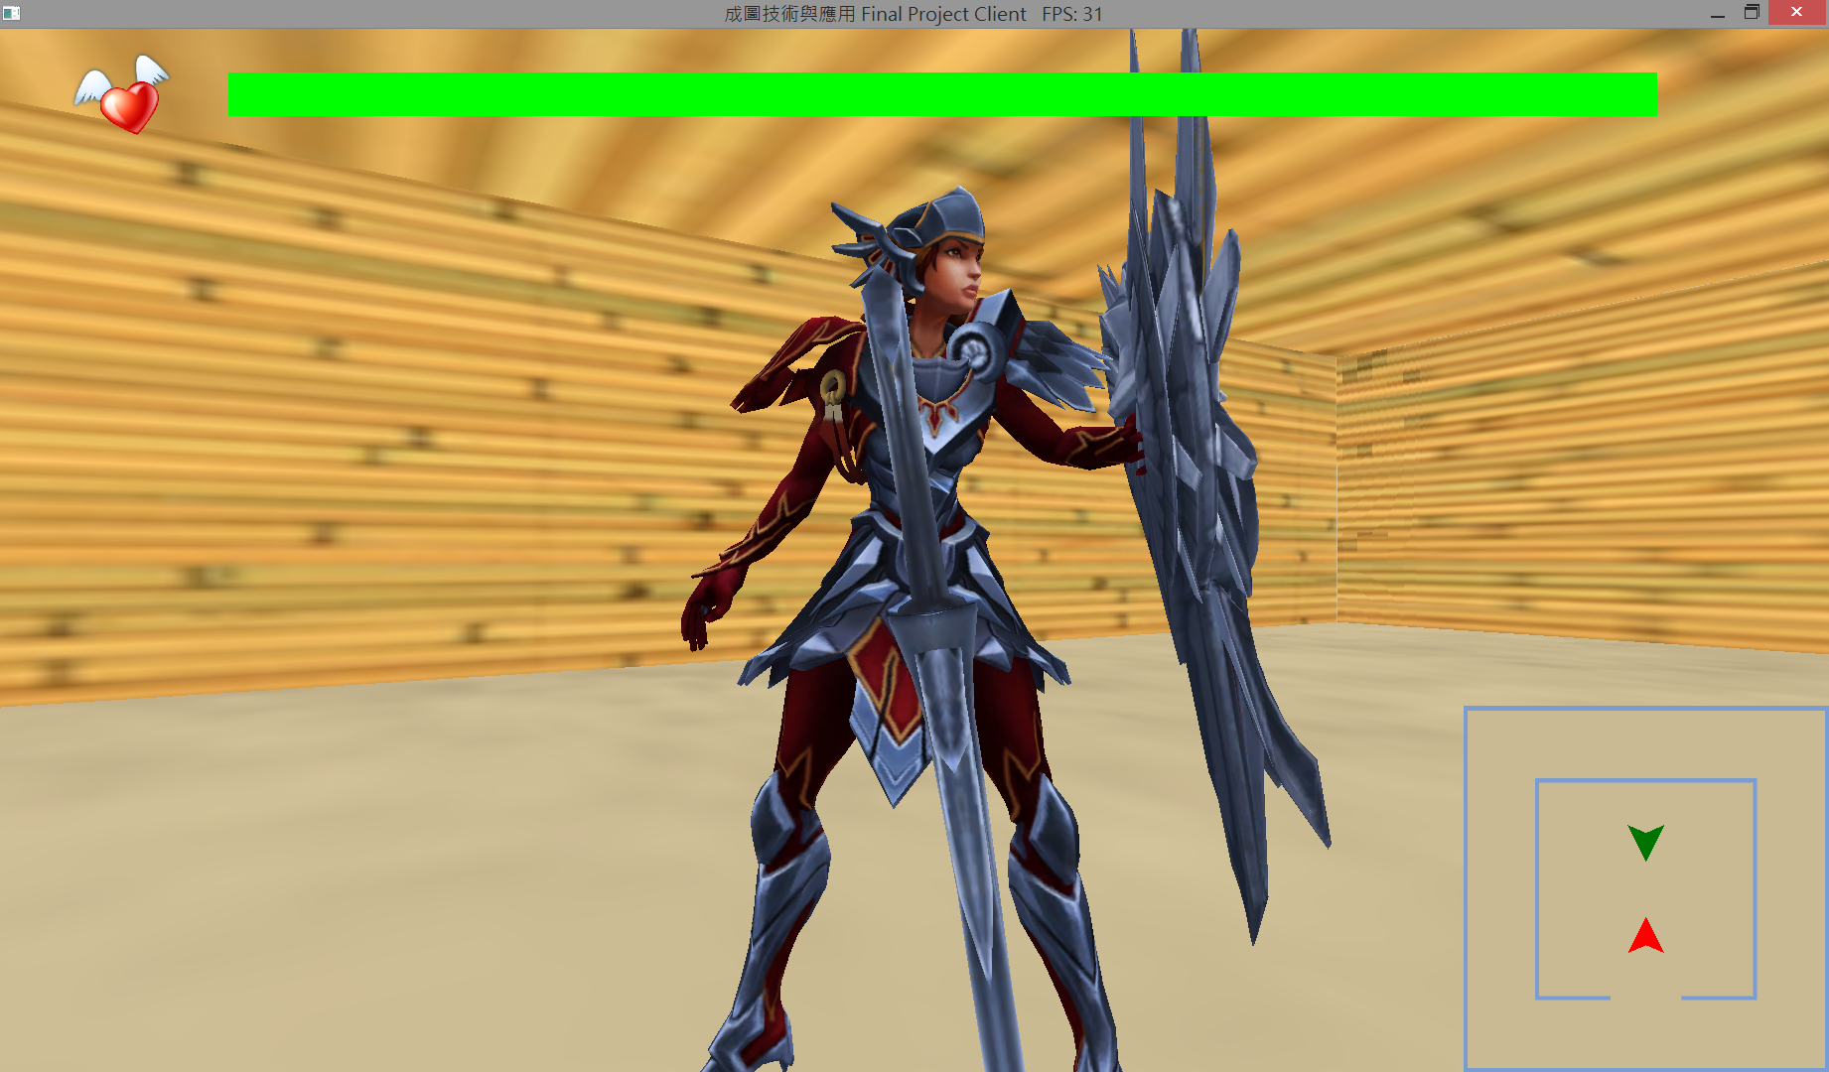
Results

Slide 16
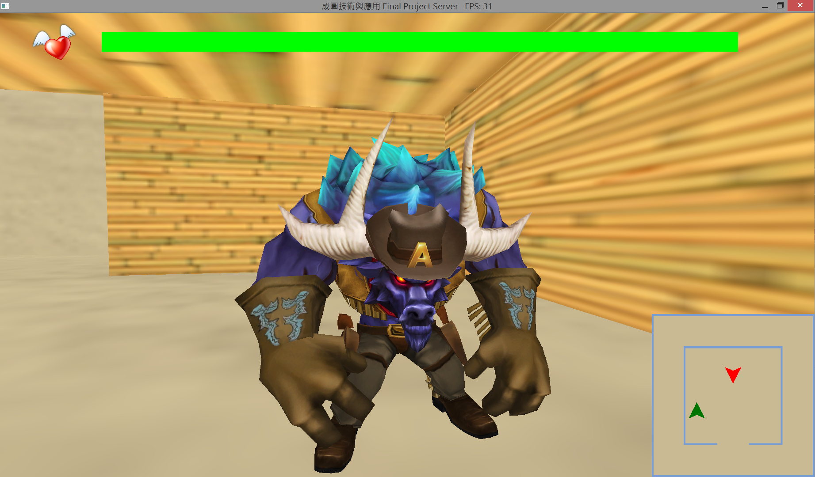
Results

Slide 17
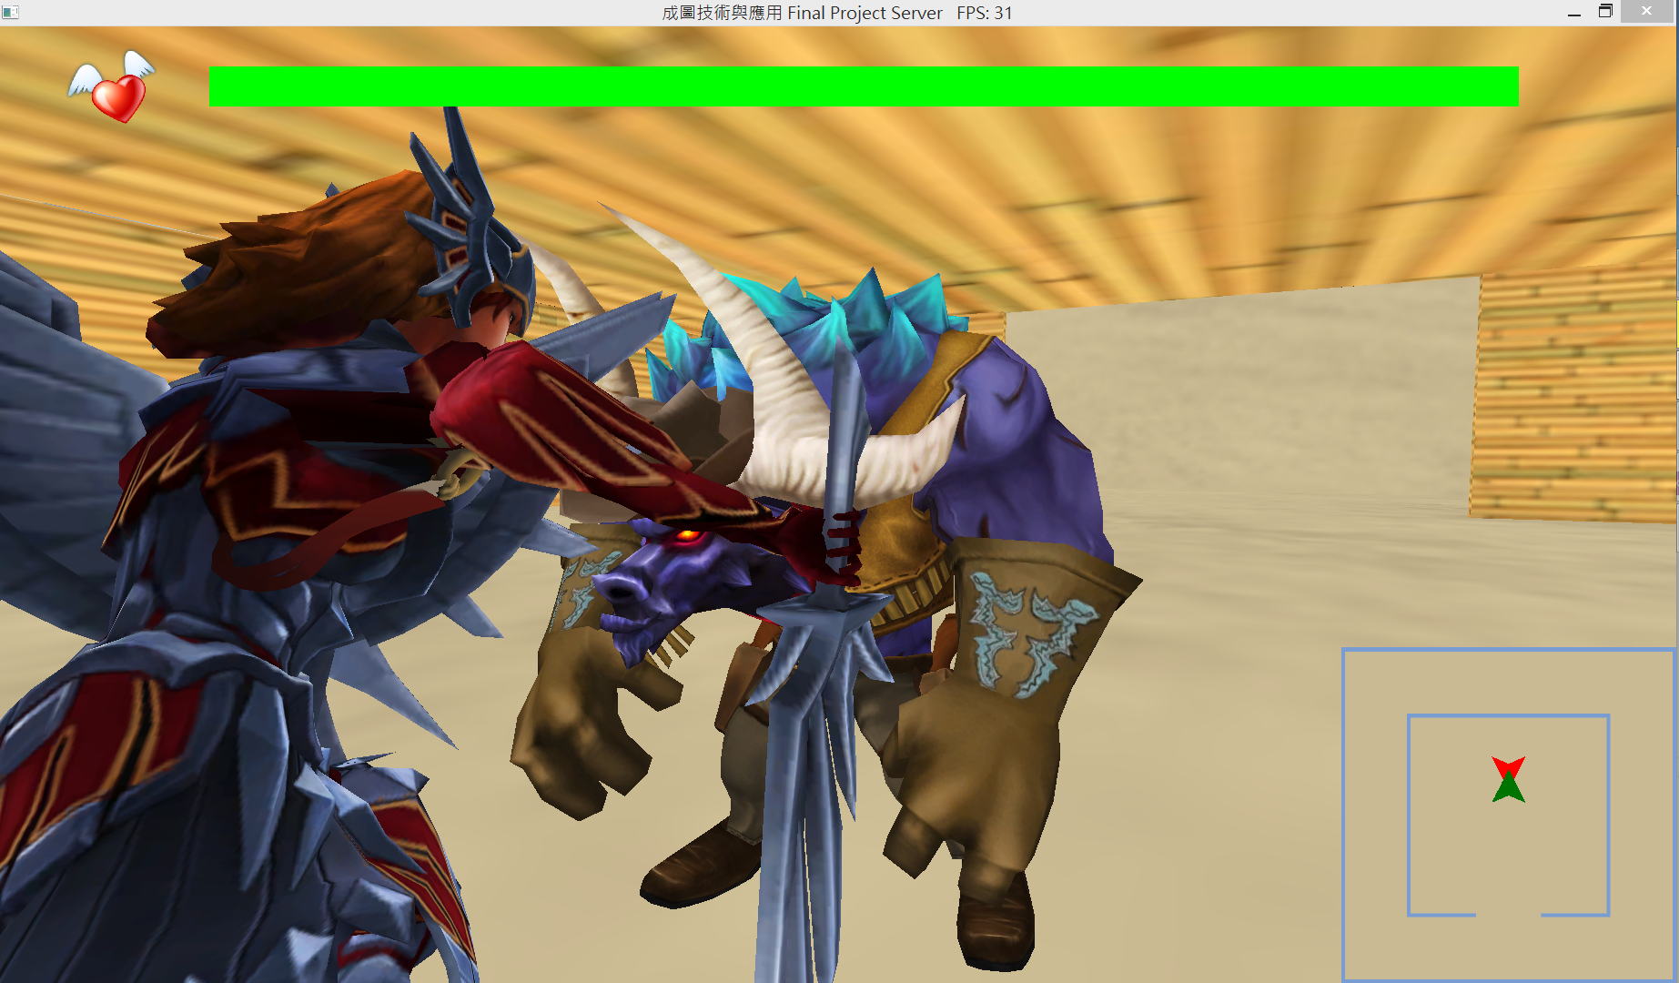
Results

Slide 18


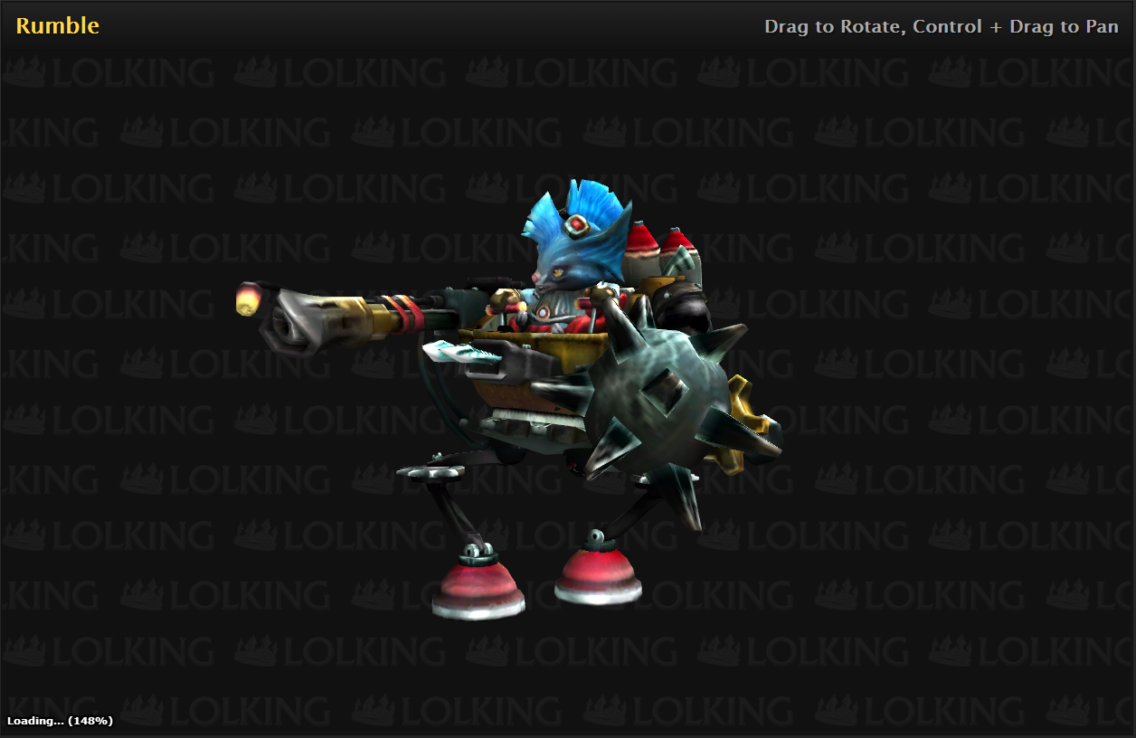

Reference
TinyXML
Autodesk Maya, 3DS MAX
Autodesk FBX SDK
League of legends
OpenGL.org

